Slide 1


Chapter 4
Network Layer:
The Data Plane
A note on the use of these Powerpoint slides:
We’re making these slides freely available to all (faculty, students, readers). They’re in PowerPoint form so you see the animations; and can add, modify, and delete slides (including this one) and slide content to suit your needs. They obviously represent a lot of work on our part. In return for use, we only ask the following:
Computer Networking: A Top Down Approach
If you use these slides (e.g., in a class) that you mention their source (after all, we’d like people to use our book!)
If you post any slides on a www site, that you note that they are adapted from (or perhaps identical to) our slides, and note our copyright of this material.
Thanks and enjoy! JFK/KWR
All material copyright 1996-2016
J.F Kurose and K.W. Ross, All Rights Reserved
7th edition
Jim Kurose, Keith Ross
Pearson/Addison Wesley
April 2016
Network Layer: Data Plane
4-<number>

Slide 2
Chapter 4: network layer
chapter goals:
understand principles behind network layer services, focusing on data plane:
  network layer service models
  forwarding versus routing
  how a router works
  generalized forwarding
instantiation, implementation in the Internet
Network Layer: Data Plane
4-<number>

Slide 3
Chapter 4: outline
4.1 Overview of Network layer
  data plane
  control plane
4.2 What’s inside a router
4.3 IP: Internet Protocol
  datagram format
  fragmentation
  IPv4 addressing
  network address translation
  IPv6
4.4 Generalized Forward and SDN
  match
  action
  OpenFlow examples of match-plus-action in action
Network Layer: Data Plane
4-<number>

Slide 4
Chapter 4: outline
4.1 Overview of Network layer
  data plane
  control plane
4.2 What’s inside a router
4.3 IP: Internet Protocol
  datagram format
  fragmentation
  IPv4 addressing
  network address translation
  IPv6
4.4 Generalized Forward and SDN
  match
  action
  OpenFlow examples of match-plus-action in action
Network Layer: Data Plane
4-<number>

Slide 5
Router architecture overview
high-level view of generic router architecture:
routing, management
control plane (software)
operates in millisecond
time frame
routing
processor
forwarding data plane (hardware) operates in nanosecond timeframe
high-seed
switching
fabric
router input ports
router output ports
Network Layer: Data Plane
4-<number>

Slide 6
Input port functions
lookup,
forwarding
queueing
line
termination
link
layer
protocol
(receive)
switch
fabric
physical layer:
bit-level reception
data link layer:
e.g., Ethernet
see chapter 5
decentralized switching:
using header field values, lookup output port using forwarding table in input port memory (“match plus action”)
goal: complete input port processing at ‘line speed’
queuing: if datagrams arrive faster than forwarding rate into switch fabric
Network Layer: Data Plane
4-<number>

Slide 7
Input port functions
lookup,
forwarding
queueing
line
termination
link
layer
protocol
(receive)
switch
fabric
physical layer:
bit-level reception
decentralized switching:
using header field values, lookup output port using forwarding table in input port memory (“match plus action”)
destination-based forwarding: forward based only on destination IP address (traditional)
generalized forwarding: forward based on any set of header field values
data link layer:
e.g., Ethernet
Network Layer: Data Plane
4-<number>

Slide 8
Destination-based forwarding
forwarding table
Destination Address Range
11001000 00010111 00010000 00000000
through
11001000 00010111 00010111 11111111
11001000 00010111 00011000 00000000
through
11001000 00010111 00011000 11111111
11001000 00010111 00011001 00000000
through
11001000 00010111 00011111 11111111
otherwise
Link Interface
0
1
2
3
Network Layer: Data Plane
4-<number>

Slide 9
Longest prefix matching
longest prefix matching
when looking for forwarding table entry for given destination address, use longest address prefix that matches destination address.
Destination Address Range
11001000 00010111 00010*** *********
11001000 00010111 00011000 *********
11001000 00010111 00011*** *********
otherwise
Link interface
0
1
2
3
examples:
DA: 11001000 00010111 00010110 10100001
which interface?
DA: 11001000 00010111 00011000 10101010
which interface?
Network Layer: Data Plane
4-<number>

Slide 10
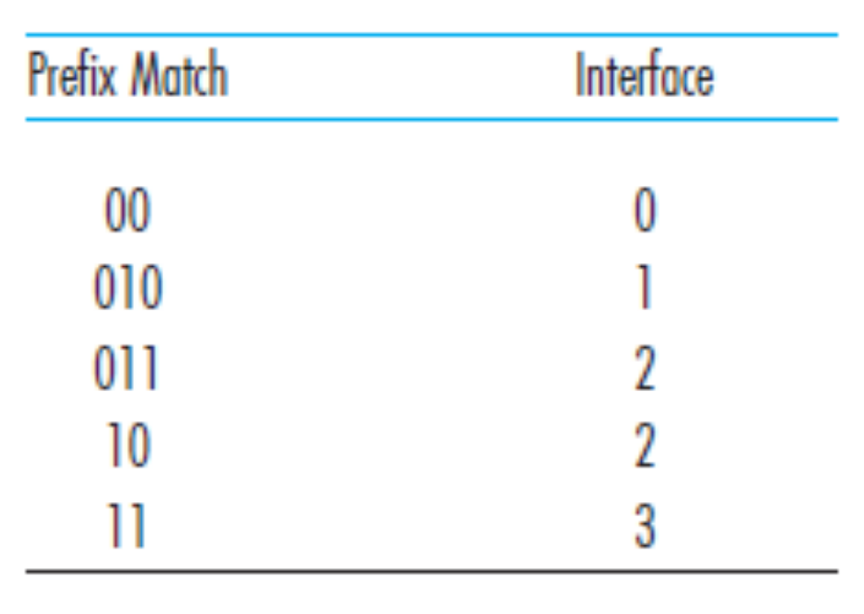
Consider a datagram network using 8-bit host addresses. Suppose a router uses longest prefix matching and has the following forwarding table:
For each of the four interfaces, give the associated range of destination host addresses and the number of addresses in the range.
Network Layer: Data Plane
4-<number>

Slide 11
Answer
Interface 0: 00000000~00111111, there are 64 addresses;
Interface 1: 01000000~01011111, there are 32 addresses;
Interface 2: 01100000~01111111 and 10000000~10111111, there are 96 addresses;
Interface 3: 11000000~11111111, there are 64 addresses;
Network Layer: Data Plane
4-<number>

Slide 12
Switching fabrics
transfer packet from input buffer to appropriate output buffer
switching rate: rate at which packets can be transfer from inputs to outputs
  often measured as multiple of input/output line rate
  N inputs: switching rate N times line rate desirable
three types of switching fabrics
memory
memory
bus
crossbar
Network Layer: Data Plane
4-<number>

Slide 13

Switching via memory
first generation routers:
traditional computers with switching under direct control of CPU
packet copied to system’s memory
speed limited by memory bandwidth (2 bus crossings per datagram)
input
port
(e.g.,
Ethernet)
output
port
(e.g.,
Ethernet)
memory
system bus
Network Layer: Data Plane
4-<number>

Slide 14
Switching via a bus
datagram from input port memory
to output port memory via a shared bus
bus contention: switching speed limited by bus bandwidth
32 Gbps bus, Cisco 5600: sufficient speed for access and enterprise routers
bus
Network Layer: Data Plane
4-<number>

Slide 15
Switching via interconnection network
Overcome bus bandwidth limitations
banyan networks, crossbar, other interconnection nets initially developed to connect processors in multiprocessor
advanced design: fragmenting datagram into fixed length cells, switch cells through the fabric.
Cisco 12000: switches 60 Gbps through the interconnection network
crossbar
Network Layer: Data Plane
4-<number>

Slide 16
Input port queuing
When fabric is slower than input ports, queueing may occur at input queues
  queueing delay and loss due to input buffer overflow!
Head-of-the-Line (HOL) blocking: queued datagram at front of queue prevents others in queue from moving forward
switch
fabric
switch
fabric
output port contention:
only one red datagram can be transferred.
lower red packet is blocked
one packet time later: green packet experiences HOL blocking
Network Layer: Data Plane
4-<number>

Slide 17
Output ports
datagram
buffer
queueing
switch
fabric
link
layer
protocol
(send)
line
termination
buffering required when datagrams arrive from fabric faster than the transmission rate
scheduling discipline chooses among queued datagrams for transmission
Datagram (packets) can be lost due to congestion, lack of buffers
Priority scheduling – who gets best performance, network neutrality
Network Layer: Data Plane
4-<number>

Slide 18
Output port queueing
switch
fabric
switch
fabric
at t, packets more
from input to output
one packet time later
buffering when arrival rate via switch exceeds output line speed
queueing (delay) and loss due to output port buffer overflow!
Network Layer: Data Plane
4-<number>

Slide 19
Scheduling mechanisms
scheduling: choose next packet to send on link
FIFO (first in first out) scheduling: send in order of arrival to queue
  real-world example?
  discard policy: if packet arrives to full queue: who to discard?
    tail drop: drop arriving packet
    priority: drop/remove on priority basis
    random: drop/remove randomly
packet
arrivals
packet
departures
queue
(waiting area)
link
(server)
Network Layer: Data Plane
4-<number>

Slide 20

Scheduling policies: priority
priority scheduling: send highest priority queued packet
multiple classes, with different priorities
  class may depend on marking or other header info, e.g. IP source/dest, port numbers, etc.
Non-preemptive priority queuing discipline
  The transmission of a packet is not interrupted once it has begun
high priority queue
(waiting area)
arrivals
departures
classify
link
(server)
low priority queue
(waiting area)
2
1
3
4
5
arrivals
packet in service
1
3
2
4
5
departures
1
3
2
4
5
Network Layer: Data Plane
4-<number>

Slide 21
Scheduling policies: still more
Round Robin (RR) scheduling:
multiple classes
cyclically scan class queues, sending one complete packet from each class (if available)
2
1
3
4
5
arrivals
packet in service
1
3
2
4
5
departures
1
3
3
4
5
Network Layer: Data Plane
4-<number>

Slide 22
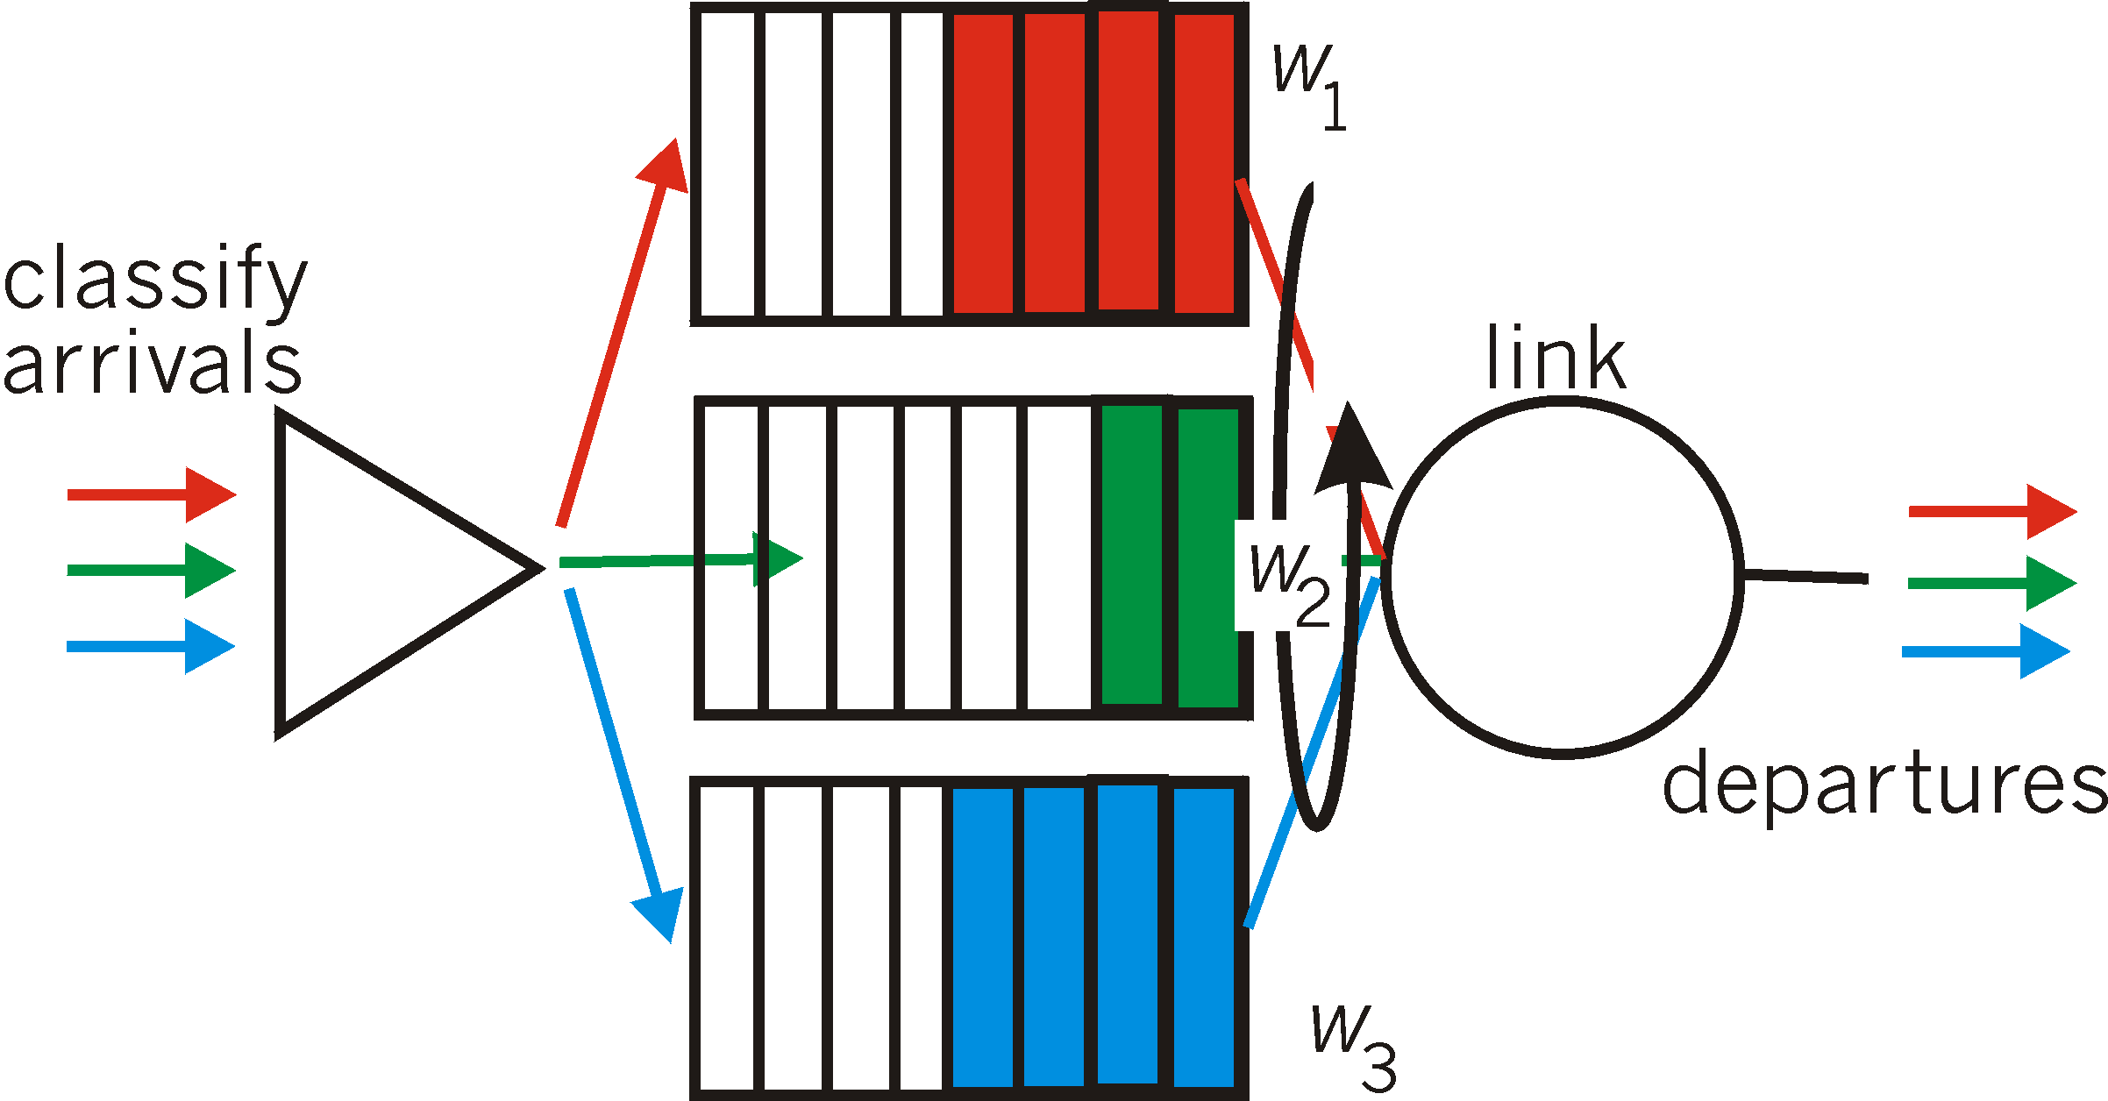
Scheduling policies: still more
Weighted Fair Queuing (WFQ):
generalized Round Robin
each class gets weighted amount of service in each cycle
  Even if all classes have queued packets, each class will still be guaranteed to receive a certain bandwith
Network Layer: Data Plane
4-<number>

Slide 23
Chapter 4: outline
4.1 Overview of Network layer
  data plane
  control plane
4.2 What’s inside a router
4.3 IP: Internet Protocol
  datagram format
  fragmentation
  IPv4 addressing
  network address translation
  IPv6
4.4 Generalized Forward and SDN
  match
  action
  OpenFlow examples of match-plus-action in action
Network Layer: Data Plane
4-<number>

Slide 24
The Internet network layer
host, router network layer functions:
transport layer: TCP, UDP
routing protocols
path selection
RIP, OSPF, BGP
IP protocol
addressing conventions
datagram format
packet handling conventions
network
layer
forwarding
table
ICMP protocol
error reporting
router “signaling”
link layer
physical layer
Network Layer: Data Plane
4-<number>

Slide 25
IP datagram format
IP protocol version
number
32 bits
total datagram
length (bytes)
header length
(bytes)
head.
len
type of
service
ver
length
for
fragmentation/
reassembly
“type” of data
flgs
fragment
offset
16-bit identifier
max number
remaining hops
(decremented at
each router)
time to
live
upper
layer
header
checksum
32 bit source IP address
upper layer protocol
to deliver payload to
32 bit destination IP address
options (if any)
e.g. timestamp,
record route
taken, specify
list of routers
to visit.
data
(variable length,
typically a TCP
or UDP segment)
how much overhead?
20 bytes of TCP
20 bytes of IP
= 40 bytes + app layer overhead
Network Layer: Data Plane
4-<number>

Slide 26

IP fragmentation, reassembly
network links have MTU (maximum transmission unit) - largest possible link-level frame
  different link types, different MTUs
large IP datagram divided (“fragmented”) within net
  one datagram becomes several datagrams
  “reassembled” only at final destination
  IP header bits used to identify, order related fragments
…
fragmentation:
in: one large datagram
out: 3 smaller datagrams
reassembly
…
Network Layer: Data Plane
4-<number>

Slide 27
Chapter 4: outline
4.1 Overview of Network layer
  data plane
  control plane
4.2 What’s inside a router
4.3 IP: Internet Protocol
  datagram format
  fragmentation
  IPv4 addressing
  network address translation
  IPv6
4.4 Generalized Forward and SDN
  match
  action
  OpenFlow examples of match-plus-action in action
Network Layer: Data Plane
4-<number>

Slide 28
IPv4 addressing: introduction
223.1.1.1
IPv4 address: 32-bit identifier for host, router interface
interface: connection between host/router and physical link
  router’s typically have multiple interfaces
  host typically has one or two interfaces (e.g., wired Ethernet, wireless 802.11)
IP addresses associated with each interface
Typically written in dotted-decimal notation
223.1.2.1
223.1.1.2
223.1.1.4
223.1.2.9
223.1.1.3
223.1.3.27
223.1.2.2
223.1.3.1
223.1.3.2
223.1.1.1 = 11011111 00000001 00000001 00000001
223
1
1
1
Network Layer: Data Plane
4-<number>

Slide 29


IP addressing: introduction
223.1.1.1
Q: how are interfaces actually connected?
A: we’ll learn about that in chapter 5, 6.
223.1.2.1
223.1.1.2
223.1.1.4
223.1.2.9
223.1.1.3
223.1.3.27
223.1.2.2
A: wired Ethernet interfaces connected by Ethernet switches
223.1.3.1
223.1.3.2
For now: don’t need to worry about how one interface is connected to another (with no intervening router)
A: wireless WiFi interfaces connected by WiFi base station
Network Layer: Data Plane
4-<number>

Slide 30
Subnets
IP address:
  subnet part - high order bits
  host part - low order bits
what’s a subnet ?
  device interfaces with same subnet part of IP address
  can physically reach each other without intervening router
223.1.1.1
223.1.1.2
223.1.2.1
223.1.1.4
223.1.2.9
223.1.2.2
223.1.1.3
223.1.3.27
subnet
223.1.3.1
223.1.3.2
network consisting of 3 subnets
Network Layer: Data Plane
4-<number>

Slide 31
Subnets
223.1.1.0/24
223.1.2.0/24
recipe
to determine the subnets, detach each interface from its host or router, creating islands of isolated networks
each isolated network is called a subnet
223.1.1.1
223.1.1.2
223.1.2.1
223.1.1.4
223.1.2.9
223.1.2.2
223.1.1.3
223.1.3.27
subnet
223.1.3.1
223.1.3.2
223.1.3.0/24
subnet mask: /24
Network Layer: Data Plane
4-<number>

Slide 32
Subnets
223.1.1.2
how many?
223.1.1.1
223.1.1.4
223.1.1.3
223.1.9.2
223.1.7.0
223.1.9.1
223.1.7.1
223.1.8.1
223.1.8.0
223.1.2.6
223.1.3.27
223.1.2.1
223.1.2.2
223.1.3.1
223.1.3.2
Network Layer: Data Plane
4-<number>
Notes:
Answer:
6

Slide 33
IP addressing: CIDR
CIDR: Classless InterDomain Routing
  address format: a.b.c.d/x, where x is # bits in subnet portion of address
  Broadcast address: 255.255.255.255
subnet
part
host
part
11001000 00010111 00010000 00000000
200.23.16.0/23
Network Layer: Data Plane
4-<number>

Slide 34
IP addresses: how to get one?
Q: how does network get subnet part of IP addr?
A: gets allocated portion of its provider ISP’s address space
ISP's block 11001000 00010111 00010000 00000000 200.23.16.0/20
Organization 0 11001000 00010111 00010000 00000000 200.23.16.0/23
Organization 1 11001000 00010111 00010010 00000000 200.23.18.0/23
Organization 2 11001000 00010111 00010100 00000000 200.23.20.0/23
... ….. …. ….
Organization 7 11001000 00010111 00011110 00000000 200.23.30.0/23
Network Layer: Data Plane
4-<number>

Slide 35
IP addressing: the last word...
Q: how does an ISP get block of addresses?
A: ICANN: Internet Corporation for Assigned
Names and Numbers http://www.icann.org/
  allocates addresses
  manages DNS
  assigns domain names, resolves disputes
Network Layer: Data Plane
4-<number>

Slide 36
Subnet IP address assignment
Consider a router that interconnects three subnets: Subnet 1, Subnet 2, and Subnet 3. Suppose all of the interfaces in each of these three subnets are required to have the prefix 223.1.17/24. Also suppose that Subnet 1 is required to support 120 interfaces, Subnet 2 is to support 60 interfaces, and Subnet 3 is to support 60 interfaces. Provide three network addresses (of the form a.b.c.d/x) that satisfy these constraints.
Network Layer: Data Plane
4-<number>

Slide 37
Answer
Subnet 1: 223.1.17.0/25
Subnet 2: 223.1.17.128/26
Subnet 3: 223.1.17.192/26
Network Layer: Data Plane
4-<number>

Slide 38
IP addresses: how to get one?
Q: How does a host get IP address?
hard-coded by system admin in a file
  Windows: control-panel->network->configuration->tcp/ip->properties
  UNIX: /etc/rc.config
DHCP: Dynamic Host Configuration Protocol: dynamically get address from network server
  “plug-and-play” protocol
Network Layer: Data Plane
4-<number>

Slide 39
DHCP: Dynamic Host Configuration Protocol
goal: allow host to dynamically obtain its IP address from network server when it joins network
  can renew its lease time on address in use
  allows reuse of addresses (only hold address while connected/“on”)
  support for mobile users who want to join network (more shortly)
DHCP overview:
  host broadcasts “DHCP discover” msg [optional]
  DHCP server responds with “DHCP offer” msg [optional]
  host requests IP address: “DHCP request” msg
  DHCP server sends address: “DHCP ack” msg
Network Layer: Data Plane
4-<number>

Slide 40


DHCP client-server scenario
DHCP
server
223.1.1.0/24
223.1.1.1
223.1.2.1
223.1.1.2
arriving DHCP
client needs
address in this
network
223.1.1.4
223.1.2.9
223.1.3.27
223.1.2.2
223.1.1.3
223.1.2.0/24
223.1.3.1
223.1.3.2
223.1.3.0/24
Network Layer: Data Plane
4-<number>

Slide 41
DHCP client-server scenario
DHCP server: 223.1.2.5
DHCP discover
arriving
client
src : 0.0.0.0, 68
dest.: 255.255.255.255,67
yiaddr: 0.0.0.0
transaction ID: 654
Broadcast: is there a DHCP server out there?
DHCP offer
src: 223.1.2.5, 67
dest: 255.255.255.255, 68
yiaddrr: 223.1.2.4
transaction ID: 654
lifetime: 3600 secs
Broadcast: I’m a DHCP server! Here’s an IP address you can use
DHCP request
src: 0.0.0.0, 68
dest:: 255.255.255.255, 67
yiaddrr: 223.1.2.4
transaction ID: 655
lifetime: 3600 secs
Broadcast: OK. I’ll take that IP address!
DHCP ACK
src: 223.1.2.5, 67
dest: 255.255.255.255, 68
yiaddrr: 223.1.2.4
transaction ID: 655
lifetime: 3600 secs
Broadcast: OK. You’ve got that IP address!
Network Layer: Data Plane
4-<number>

Slide 42
DHCP: more than IP addresses
DHCP server can return more than just allocated IP address on subnet:
  address of first-hop router for client
  name and IP address of DNS sever
  network mask (indicating network versus host portion of address)
Network Layer: Data Plane
4-<number>

Slide 43
NAT: network address translation
rest of
Internet
local network
(e.g., home network)
10.0.0/24
10.0.0.1
10.0.0.4
10.0.0.2
138.76.29.7
10.0.0.3
all datagrams leaving local
network have same single source NAT IP address: 138.76.29.7,different source port numbers
all four interfaces in the home
network have the same subnet
address of 10.0.0.0/24 that can
only have meaning within the
given home network
Network Layer: Data Plane
4-<number>

Slide 44
NAT: network address translation
motivation: local network uses just one IP address as far as outside world is concerned:
  range of addresses not needed from ISP: to outside world, just one IP address for all devices
  can change addresses of devices in local network without notifying outside world
  can change ISP without changing addresses of devices in local network
  devices inside local net not explicitly addressable, visible by outside world (a security plus)
Network Layer: Data Plane
4-<number>

Slide 45
NAT: network address translation
implementation: NAT router must:
  outgoing datagrams: replace (source IP address, port #) of every outgoing datagram to (NAT IP address, new port #)
    . . . remote clients/servers will respond using (NAT IP address, new port #) as destination addr
  remember (in NAT translation table) every (source IP address, port #) to (NAT IP address, new port #) translation pair
  incoming datagrams: replace (NAT IP address, new port #) in dest fields of every incoming datagram with corresponding (source IP address, port #) stored in NAT table
Network Layer: Data Plane
4-<number>

Slide 46
NAT: network address translation
NAT translation table
WAN side addr LAN side addr
2: NAT router
changes datagram
source addr from
10.0.0.1, 3345 to
138.76.29.7, 5001,
updates table
1: host 10.0.0.1
sends datagram to
128.119.40.186, 80
138.76.29.7, 5001 10.0.0.1, 3345
…… ……
S: 10.0.0.1, 3345
D: 128.119.40.186, 80
10.0.0.1
1
2
S: 138.76.29.7, 5001
D: 128.119.40.186, 80
10.0.0.4
10.0.0.2
138.76.29.7
S: 128.119.40.186, 80
D: 10.0.0.1, 3345
4
S: 128.119.40.186, 80
D: 138.76.29.7, 5001
3
10.0.0.3
4: NAT router
changes datagram
dest addr from
138.76.29.7, 5001 to 10.0.0.1, 3345
3: reply arrives
dest. address:
138.76.29.7, 5001
* Check out the online interactive exercises for more examples: http://gaia.cs.umass.edu/kurose_ross/interactive/
Network Layer: Data Plane
4-<number>

Slide 47
NAT: network address translation
16-bit port-number field:
  60,000 simultaneous connections with a single LAN-side address!
NAT is controversial:
  routers should only process up to layer 3
  address shortage should be solved by IPv6
  violates end-to-end argument
    NAT possibility must be taken into account by app designers, e.g., P2P applications
Network Layer: Data Plane
4-<number>

Slide 48
Chapter 4: outline
4.1 Overview of Network layer
  data plane
  control plane
4.2 What’s inside a router
4.3 IP: Internet Protocol
  datagram format
  fragmentation
  IPv4 addressing
  network address translation
  IPv6
4.4 Generalized Forward and SDN
  match
  action
  OpenFlow examples of match-plus-action in action
Network Layer: Data Plane
4-<number>

Slide 49
IPv6: motivation
initial motivation: 32-bit address space soon to be completely allocated.
additional motivation:
  header format helps speed processing/forwarding
  header changes to facilitate QoS
IPv6 datagram format:
  fixed-length 40 byte header
  no fragmentation allowed
Network Layer: Data Plane
4-<number>

Slide 50
IPv6 datagram format
priority: identify priority among datagrams in flow
flow Label: identify datagrams in same “flow.”
(concept of“flow” not well defined).
next header: identify upper layer protocol for data
ver
pri
flow label
payload len
next hdr
hop limit
source address
(128 bits)
destination address
(128 bits)
data
32 bits
Network Layer: Data Plane
4-<number>

Slide 51
Other changes from IPv4
checksum: removed entirely to reduce processing time at each hop
options: allowed, but outside of header, indicated by “Next Header” field
ICMPv6: new version of ICMP
  additional message types, e.g. “Packet Too Big”
  multicast group management functions
Network Layer: Data Plane
4-<number>

Slide 52
Transition from IPv4 to IPv6
not all routers can be upgraded simultaneously
  no “flag days”
  how will network operate with mixed IPv4 and IPv6 routers?
tunneling: IPv6 datagram carried as payload in IPv4 datagram among IPv4 routers
IPv4 header fields
IPv6 header fields
IPv4 payload
IPv4 source, dest addr
IPv6 source dest addr
UDP/TCP payload
IPv6 datagram
IPv4 datagram
Network Layer: Data Plane
4-<number>

Slide 53
Tunneling
A
B
IPv4 tunnel
connecting IPv6 routers
E
F
logical view:
IPv6
IPv6
IPv6
IPv6
A
B
C
D
E
F
physical view:
IPv6
IPv6
IPv4
IPv4
IPv6
IPv6
Network Layer: Data Plane
4-<number>

Slide 54
Tunneling
A
B
IPv4 tunnel
connecting IPv6 routers
E
F
logical view:
IPv6
IPv6
IPv6
IPv6
A
B
C
D
E
F
physical view:
IPv6
IPv6
IPv4
IPv4
IPv6
IPv6
flow: X
src: A
dest: F
data
src:B
dest: E
src:B
dest: E
flow: X
src: A
dest: F
data
Flow: X
Src: A
Dest: F
data
Flow: X
Src: A
Dest: F
data
A-to-B:
IPv6
B-to-C:
IPv6 inside
IPv4
B-to-C:
IPv6 inside
IPv4
E-to-F:
IPv6
Network Layer: Data Plane
4-<number>

Slide 55
Chapter 4: outline
4.1 Overview of Network layer
  data plane
  control plane
4.2 What’s inside a router
4.3 IP: Internet Protocol
  datagram format
  fragmentation
  IPv4 addressing
  network address translation
  IPv6
4.4 Generalized Forward and SDN
  match
  action
  OpenFlow examples of match-plus-action in action
Network Layer: Data Plane
4-<number>

Slide 56



Generalized Forwarding and SDN
Each router contains a flow table that is computed and distributed by a logically centralized routing controller
logically-centralized routing controller
control plane
data plane
local flow table
headers counters actions
1
0100 1101
3
2
values in arriving
packet’s header
Network Layer: Data Plane
4-<number>

Slide 57
OpenFlow data plane abstraction
flow: defined by header fields
generalized forwarding: simple packet-handling rules
  Pattern: match values in packet header fields
  Actions: for matched packet: drop, forward, modify matched packet or send matched packet to controller
  Priority: disambiguate overlapping patterns
  Counters: #packets and time
Flow table in a router (computed and distributed by controller) define router’s match-plus-action rules
Network Layer: Data Plane
4-<number>

Slide 58
OpenFlow data plane abstraction
flow: defined by header fields
generalized forwarding: simple packet-handling rules
  Pattern: match values in packet header fields
  Actions: for matched packet: drop, forward, modify, matched packet or send matched packet to controller
  Priority: disambiguate overlapping patterns
  Counters: #bytes and #packets
* : wildcard
src=1.2.*.*, dest=3.4.5.* → drop
src = *.*.*.*, dest=3.4.*.* → forward(2)
3. src=10.1.2.3, dest=*.*.*.* → send to controller

Slide 59
OpenFlow: Flow Table Entries
Rule
Action
Stats
Packet + byte counters
Forward packet to port(s)
Encapsulate and forward to controller
Drop packet
Send to normal processing pipeline
Modify Fields
Switch
Port
VLAN
ID
MAC
src
MAC
dst
Eth
type
IP
Src
IP
Dst
IP
Prot
TCP
sport
TCP
dport
Link layer
Network layer
Transport layer

Slide 60
Examples
Destination-based forwarding:
Switch
Port
MAC
src
MAC
dst
Eth
type
VLAN
ID
IP
Src
IP
Dst
IP
Prot
TCP
sport
TCP
dport
Action
*
*
*
*
*
*
51.6.0.8
*
*
*
Forward(6)
IP datagrams destined to IP address 51.6.0.8 should be forwarded to router output port 6
Firewall:
Switch
Port
MAC
src
MAC
dst
Eth
type
VLAN
ID
IP
Src
IP
Dst
IP
Prot
TCP
sport
TCP
dport
Action
*
*
*
*
*
*
*
*
*
22
drop
do not forward (block) all datagrams destined to TCP port 22
Switch
Port
MAC
src
MAC
dst
Eth
type
VLAN
ID
IP
Src
IP
Dst
IP
Prot
TCP
sport
TCP
dport
Action
*
*
*
*
*
128.119.1.1
*
*
*
*
drop
do not forward (block) all datagrams sent by host 128.119.1.1

Slide 61
Examples
Destination-based layer 2 (switch) forwarding:
Switch
Port
MAC
src
MAC
dst
Eth
type
VLAN
ID
IP
Src
IP
Dst
IP
Prot
TCP
sport
TCP
dport
Action
*
22:A7:23:
11:E1:02
*
*
*
*
*
*
*
*
Forward(6)
layer 2 frames from MAC address 22:A7:23:11:E1:02 should be forwarded to output port 6
Network Layer: Data Plane
4-<number>

Slide 62
OpenFlow abstraction
match+action: unifies different kinds of devices
Router
  match: longest destination IP prefix
  action: forward out a link
Switch
  match: destination MAC address
  action: forward or flood
Firewall
  match: IP addresses and TCP/UDP port numbers
  action: permit or deny
NAT
  match: IP address and port
  action: rewrite address and port
Network Layer: Data Plane
4-<number>

Slide 63


OpenFlow example
Example: datagrams from hosts h5 and h6 should be sent to h3 or h4, via s1 and from there to s2
match
action
IP Src = 10.3.*.*
IP Dst = 10.2.*.*
forward(3)
Host h6
10.3.0.6
1
s3
controller
2
3
4
Host h5
10.3.0.5
1
s1
s2
1
2
Host h4
10.2.0.4
4
2
4
Host h1
10.1.0.1
3
3
Host h2
10.1.0.2
match
action
match
action
Host h3
10.2.0.3
ingress port = 2
IP Dst = 10.2.0.3
ingress port = 2
IP Dst = 10.2.0.4
forward(3)
ingress port = 1
IP Src = 10.3.*.*
IP Dst = 10.2.*.*
forward(4)
forward(4)

Slide 64
Chapter 4: done!
4.1 Overview of Network layer: data plane and control plane
4.2 What’s inside a router
4.3 IP: Internet Protocol
  datagram format
  fragmentation
  IPv4 addressing
  NAT
  IPv6
4.4 Generalized Forward and SDN
  match plus action
  OpenFlow example
Question: how do forwarding tables (destination-based forwarding) or flow tables (generalized forwarding) computed?
Answer: by the control plane (next chapter)
Network Layer: Data Plane
4-<number>

